Slide 1

Rapid EV Battery
Exchange System
JASPER EV TECH INCORPORATED - JASPER EN FRANCE
© 2025 JASPER EV TECH

Slide 2
Capital Ask
Seeking €2M- €3 from early-stage investors to:
Manufacture Jasper System battery exchange prototypes
Position company for bond issuance and scaling
Early -Stage Investors receive:
Repayment from initial bond proceeds
Or may exercise option for conversion to Preferred Stock
© 2025 JASPER EV TECH

Slide 3

The Climate Crisis
The climate crisis is prompting a shift toward electric vehicles.
European Union climate goals will result in a 400% increase in electric vehicles sales.
Widespread electric vehicle adoption requires technological innovations that match the safety and convenience of internal combustion vehicles.
© 2025 JASPER EV TECH
Notes:
https://www.spglobal.com/commodity-insights/en/news-research/latest-news/metals/012825-eu-europe-focus-on-increasing-ev-uptake-to-phase-out-ice-sales-by-2035

Slide 4
Widespread EV adoption
has been stalled by range anxiety, time consuming recharging, and problematic Lithium Ion battery systems.
© 2025 JASPER EV TECH

Slide 5
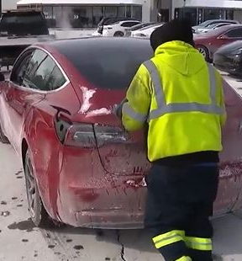
Limitations of Technology
Overheating causes fires and vehicle damage.
Cold weather reduces charging reliability.
Slow charging limits user convenience.
Short battery lifespan inflates costs.
© 2025 JASPER EV TECH
WWW.JASPEREVTECHINC.COM

Slide 6
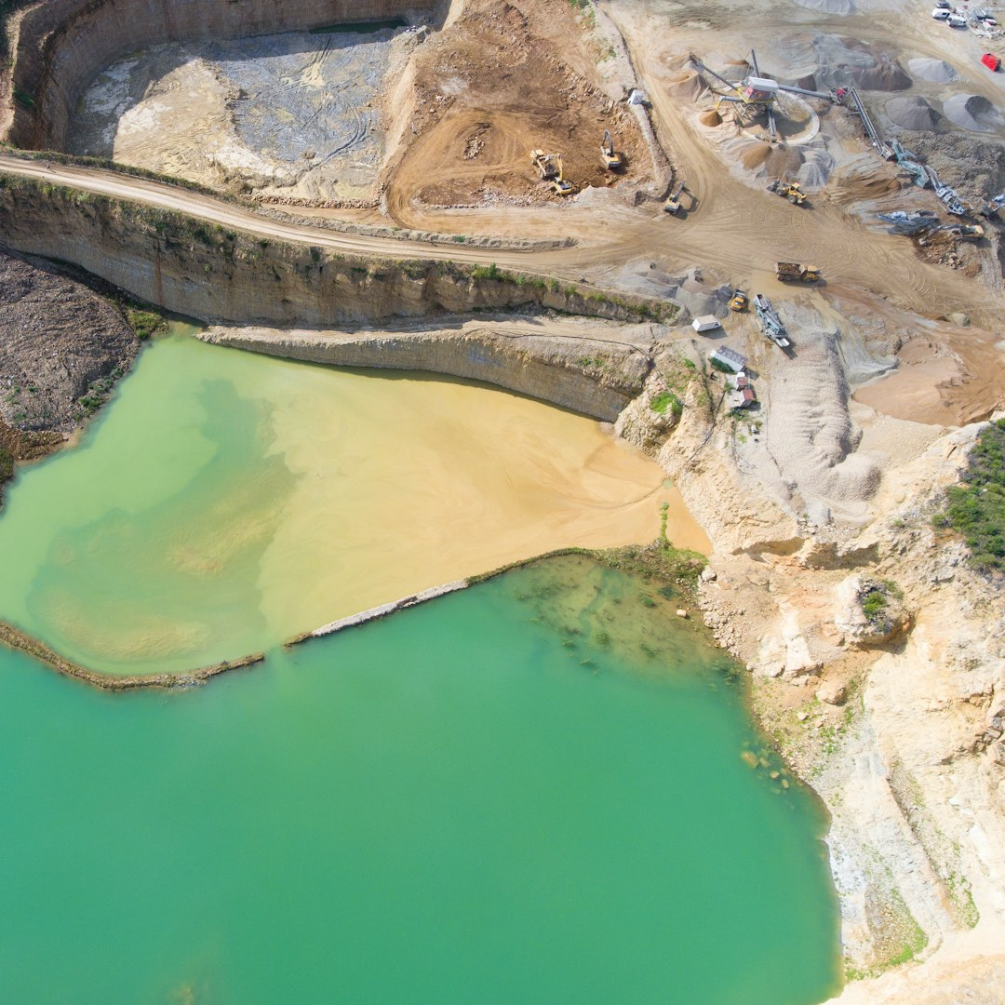
Economic, Environmental and Ethical Factors
High battery costs keep EV prices elevated.
Insurance premiums rise due to fire risks.
Nickel and cobalt are scarce, unethically sourced, and emission heavy to refine.
Environmental impact of battery production erodes EV sustainability gains.
© 2025 JASPER EV TECH
© 2025 JASPER EV TECH
WWW.JASPEREVTECHINC.COM
© 2025 JASPER EV TECH
WWW.JASPEREVTECHINC.COM

Slide 7
The Jasper System eliminates charging delays, ethical concerns, and fire risk with exchange-based system.
© 2025 JASPER EV TECH

Slide 8
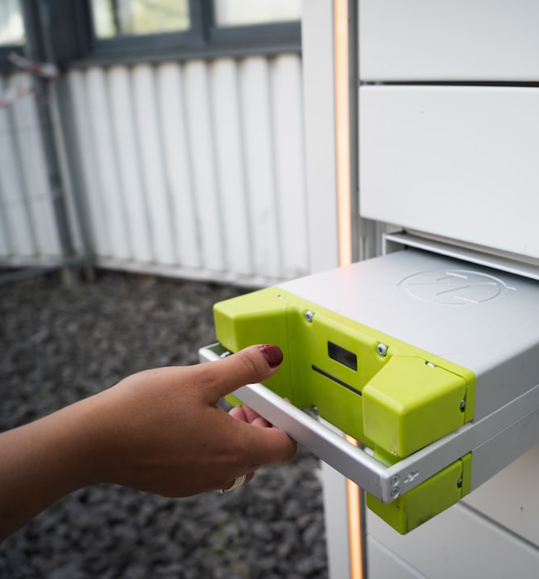
Jasper Exchange System
No cobalt/nickel: Ethical, abundant, low-cost.
Safer: Thermal stability prevents fire.
Cold-proof: Reliable performance in winter.
Convenience: Automated Battery exchange completed in under two minutes.
Eco-friendly: Each Lithium Ferrous Phosphate battery saves up to 11,000 pounds of CO₂.
© 2025 JASPER EV TECH

Slide 9
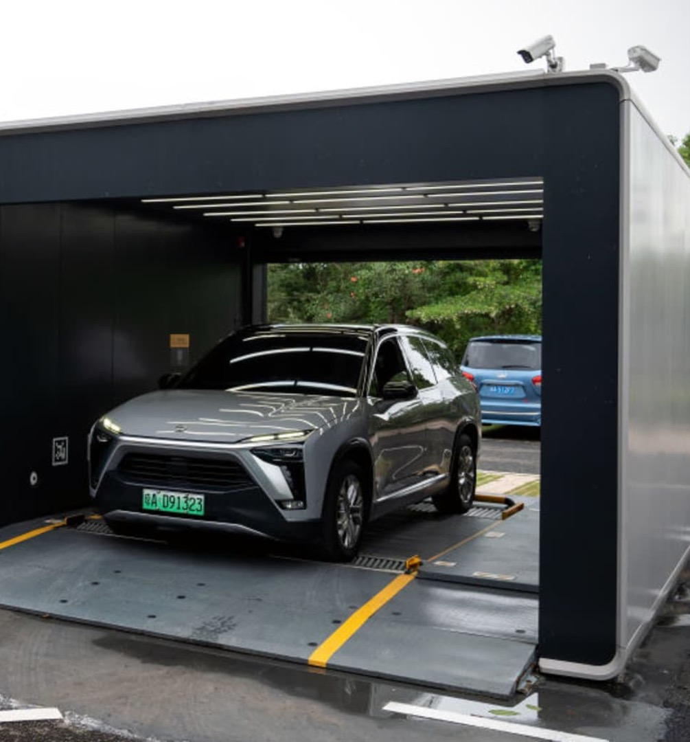
Proof it Works
NIO’s battery exchange model demonstrates clear success:
  Over 2,000 stations deployed in China/Germany
  Millions of battery exchanges conducted.
  Reduced urban congestion and downtime.
We leverage their success to validate the Jasper System model—improving upon it with faster, safer, cleaner, and more cost-efficient technology.
© 2025 JASPER EV TECH

Slide 10
Jasper vs. NIO Battery Exchange Systems
Jasper
NIO
Compatibility: Compatible with multiple EV brands. Supports rather than competes with EU auto manufacturers. Hybrid Charging Capability: Protects existing infrastructure investment. Allows for both battery exchange and plug-in charging (home, office, roadside). T hermal and BMS Architecture: Jasper LIFEPO4 batteries allow thermal management and BMS to be offloaded to the exchange station rather than integrated into the vehicle. Lowers cost to consumers. Grid Integration: Robust battery inventory allows recharging of depleted batteries during off peak hours as needed. Regulatory Compliance: Privately held IP with endorsements from EU governments of Germany, Austria, France, Italy, as well as Switzerland, Lichtenstein.BatteryExchange: Seamless process without the need to remove the depleted battery before inserting the new one. Modular Battery Loading: Supports multiple batteries for larger vehicles. | Compatibility: Proprietary system exclusive to NIO vehicles which are manufactured in China. Competes with EU auto manufacturers. Hybrid Charging Capability: Primarily relies on battery swapping stations.​ Thermal and BMS Architecture: Integrated thermal and battery management within each vehicle raising vehicle cost and maintenance. Grid Integration: Centralized model with local electricity demand spikes. Regulatory Compliance: China-based operations with current regulatory concerns in the EU. Battery Exchange: Requires removal of the depleted battery before installing a new one. Modular Battery Loading: Fixed single-pack system.

Slide 11
IP Strength & Protection
Granted patents: US9637093B2, EP2885170B1, MX2015011785A, and national EU filings
Key claims: seamless battery exchange, modular installation, multi-pack scalability, voltage-matching inverter
Jurisdictions: US, Mexico, France, Germany, Italy, Austria, Switzerland
Issued before competing applications by Tesla and others
Defensive positioning against AMPLE, NIO, Tesla — with enforceable claims

Slide 12
IP Valuation & Collateral Potential
Valuation by Green Carbon Recovery (Dec 2022):
• Low: $25.65M | High: $67.2M (2025)
• Projected 2050: $6.4B–$16.8B based on TAM/SAM licensing
UCC lien and USPTO assignment ready
Licensed-use model: €250/vehicle + €2 per swap
IP-backed revenue validated by ongoing Volkswagen B2B talks
Zero-cobalt batteries align with ESG mandates.

Slide 13
Proposed IP-Backed Loan Structure
Loan amount requested: $2M–$5M (USD)
Use of funds: prototype manufacturing, EU facility setup, licensing expansion
Collateral: Jasper Patent Family – fully granted & valued
Term: 3–5 years | Buyout or conversion option at maturity
Structured for non-dilutive capital with strategic IP leaseback

Slide 14
Market Opportunity in the European Union
By 2030, 30M EVs projected in Europe.
Innovative Jasper System addresses Urban EV challenges.
Millions of vehicles + thousands of exchange stations = billions in infrastructure revenue.
Jasper captures a premium service market with green incentives & manufacturer partnerships.
© 2025 JASPER EV TECH

Slide 15

Strategic & Commercial Progress
Early-stage agreement with top EU Electric Vehicle manufacturer to be an internal supplier of parts
In conversation with Swisslog France to supply exchange station mechanisms
Battery Recycling Plant and Factory with Siemens France automation equipment
Discussions with city governments and multiple Ministries in France
© 2025 JASPER EV TECH

Slide 16
Batteries-as-a-Service (BaaS)
© 2025 JASPER EV TECH

Slide 17
Revenue Streams
Recurring revenue generated per battery exchange.
License technology to electric vehicle manufacturers for integration.
Sale of carbon credits.
Franchise exchange stations.
© 2025 JASPER EV TECH

Slide 18
FUNDING PHASES
Phase 1 - Early Investment (€2-3M)
Build Prototype
Issuance of Climate Bond
Phase 2 - Bond (€30M)
Initial Pilot -100 vehicles with exchange stations
Facilities, Marketing, Admin and Personnel
Debt retirement
Phase 3 - Bond (€170M)
Expanded Pilot (€90M) - 500 vehicles plus exchange stations
Facilities, Marketing, Admin and Personnel
Debt retirement
Phase 4 - Bond (€300M)
EU Market Expansion
Build battery and exchange station factories
Debt retirement
© 2025 JASPER EV TECH

Slide 19
Jasper EV Tech and Climate Bond Requirements
European Green Bond Standards:
Jasper EV Tech meets or exceeds the European Union requirements for
Green Bond funding under multiple categories.
Independent Verification:
ESG-aligned certifiers (e.g., SCOPE , Sustainalytics).
Institutional Backing:
EIB and other EU bodies provide partial guarantees/co-financing.
High Demand: (Usually over-subscribed by 125%-150%)
Pension funds, ESG funds actively seek climate linked investment opportunities.
Certified by Green Carbon Recovery:
"Technically feasible, innovative, and aligned with Climate Bond ESG standards
and the Paris Accord."
© 2025 JASPER EV TECH
Notes:
ESG bonds are always oversubscribed

Slide 20
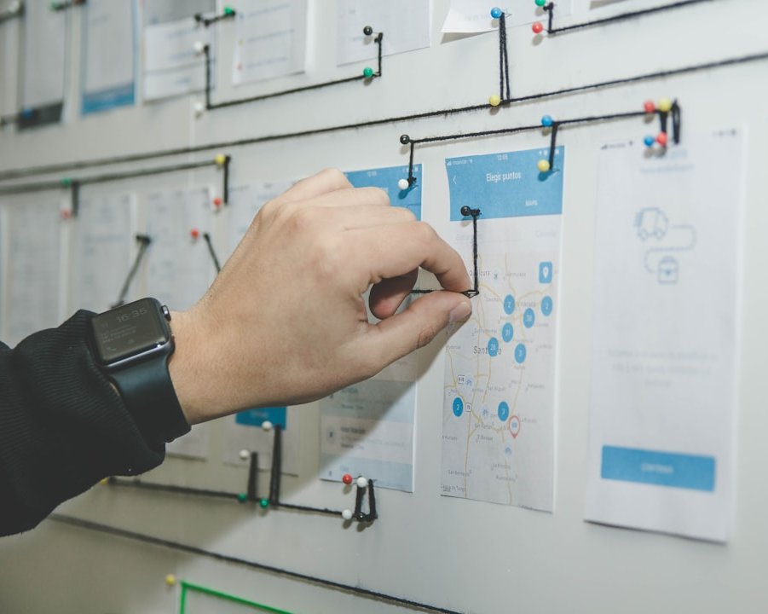


Why invest?
Strategic
Timely
Monopoly on patented IP in ethical, exchangeable EV battery system.
Partner ready with OEMs and municipalities.
Green bond ready.
Scalable
In line with EU regulation and green funding channels.
© 2025 JASPER EV TECH

Slide 21
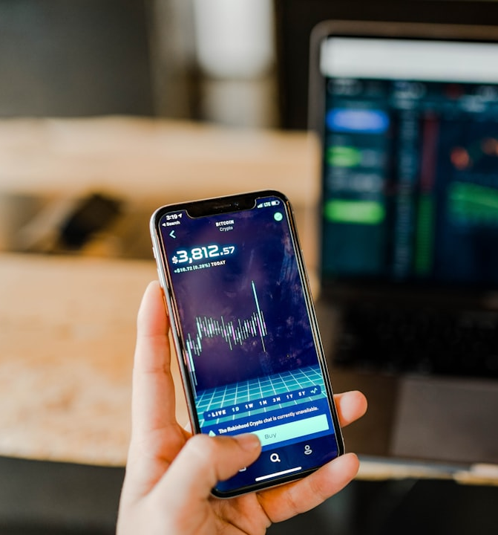
Investor Incentive
Investor repayment secured under green bond capital acquisition.
Preferred equity structure for additional early- stage investment.
Invest in a system which promotes the acceptance of EVs commercially.
© 2025 JASPER EV TECH

