Slide 1
Rapid EV Battery
Exchange System
JASPER EV TECH INCORPORATED - JASPER EN FRANCE
© 2025 JASPER EV TECH

Slide 2
Capital Ask
Seeking €2M from early-stage investors to:
1. Manufacture Jasper System battery exchange prototypes
2. Create a Minimum Viable Product to take to automakers
3. Position company for bond issuance and scaling
Early Stage Investors receive:
1. €3M repayment from initial bond proceeds within 2 years
2. Or may exercise option for conversion to €3M in Preferred Stock
© 2025 JASPER EV TECH

Slide 3
The Climate Crisis
The climate crisis is prompting a shift toward electric vehicles.
European Union climate goals will result in a 400% increase in electric vehicles sales.
Widespread electric vehicle adoption requires technological innovations that match the safety and convenience of internal combustion vehicles.
© 2025 JASPER EV TECH
Notes:
https://www.spglobal.com/commodity-insights/en/news-research/latest-news/metals/012825-eu-europe-focus-on-increasing-ev-uptake-to-phase-out-ice-sales-by-2035

Slide 4
Widespread EV adoption
has been stalled by range anxiety, time consuming recharging, and problematic Lithium Ion battery systems.
© 2025 JASPER EV TECH

Slide 5
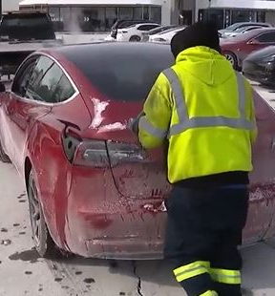
Limitations of Technology
Current charging technology is unable to replicate the ease of refuelling petrol cars:
Charging is too slow (25 + minutes)
Unreliable and easily damaged batteries
Batteries are too expensive (€10k +)
© 2025 JASPER EV TECH
WWW.JASPEREVTECHINC.COM

Slide 6
Environmental and Ethical Factors
Nickel and cobalt are scarce, unethically sourced, and emission heavy to refine.
Environmental impact of battery production erodes EV sustainability gains.
© 2025 JASPER EV TECH
© 2025 JASPER EV TECH
WWW.JASPEREVTECHINC.COM
© 2025 JASPER EV TECH
WWW.JASPEREVTECHINC.COM

Slide 7
The Jasper System eliminates charging delays, ethical concerns, and fire risk with exchange based system.
© 2025 JASPER EV TECH

Slide 8
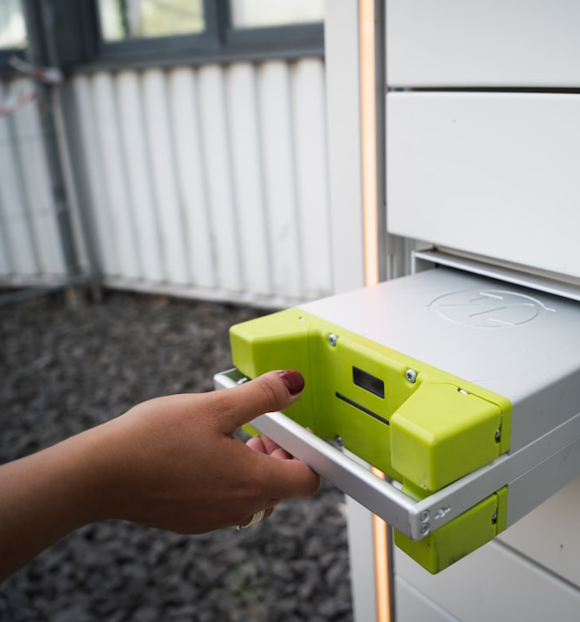
Jasper Exchange System
No cobalt/nickel: Ethical, abundant, low-cost.
Safer: Thermal stability prevents fire.
Hybrid: Charge at home and swap
Convenience: Automated Battery exchange completed in under two minutes.
Up to date: Avoid obsolescence as users get updated batteries upon release with our subscription. Never have to buy a new battery.
© 2025 JASPER EV TECH

Slide 9
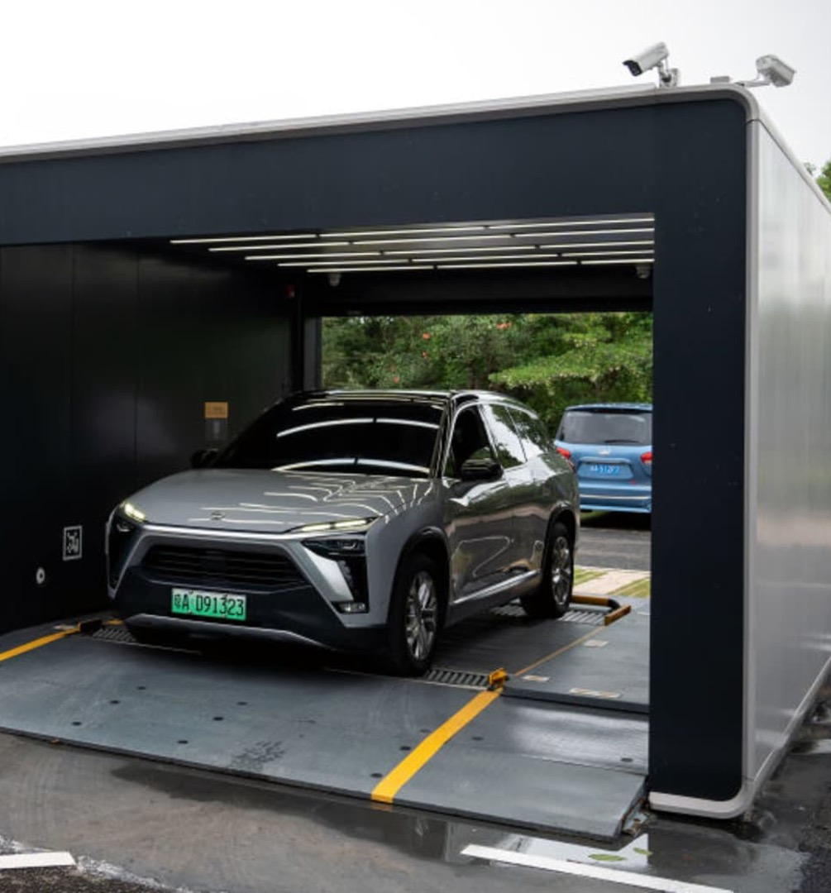
Proof that it Works
NIO’s battery exchange model demonstrates clear success:
Over 3,100 stations deployed, first in urban areas, then along major highways.
Millions of battery exchanges conducted.
Reduced urban congestion and downtime.
Now they have entered and hope to corner the exchange market in the EU.
We leverage their success to validate the Jasper System model—improving upon it with faster, safer, cleaner, and more cost-efficient technology.
© 2025 JASPER EV TECH

Slide 10
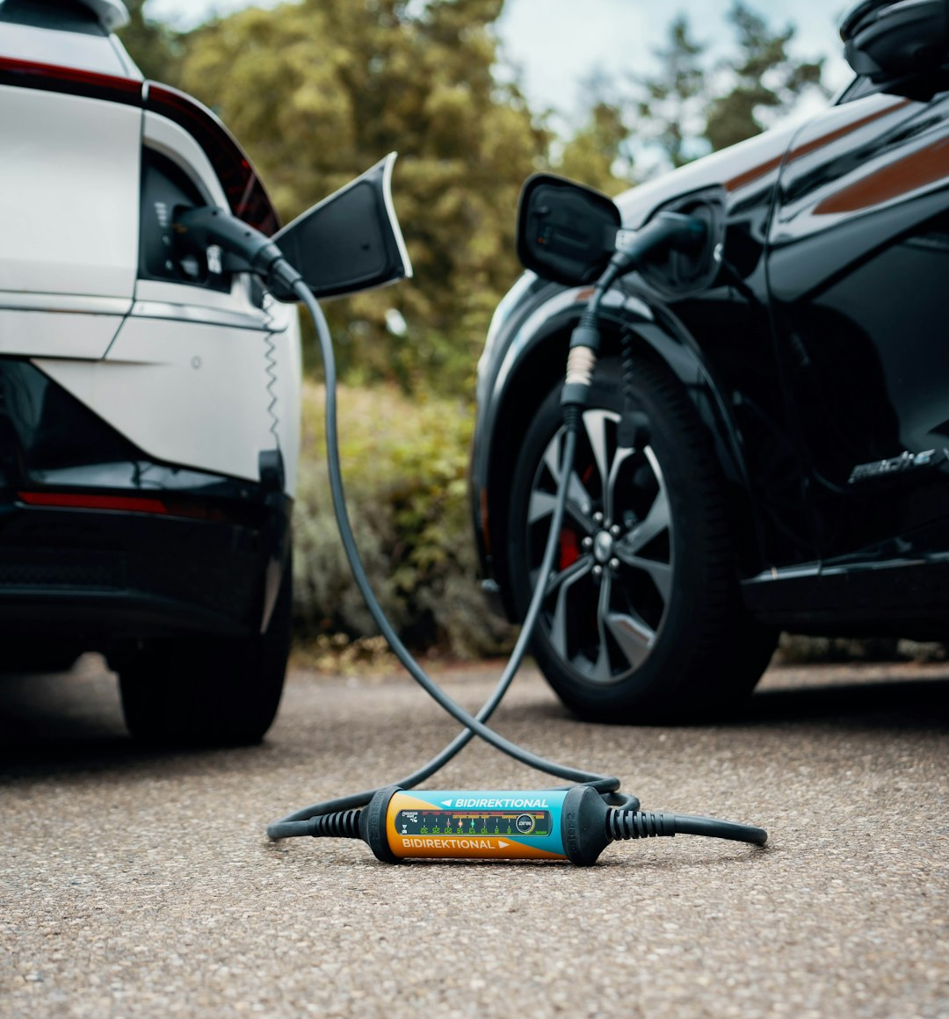
NIO 1000kW chargers
NIO developing 1000kW chargers for ultra-fast EV charging:
Adds up to 400 km of range in just 5 minutes
Requires ~1 megawatt per station—major grid load
Trials in Europe but no widespread adoption
© 2025 JASPER EV TECH

Slide 11
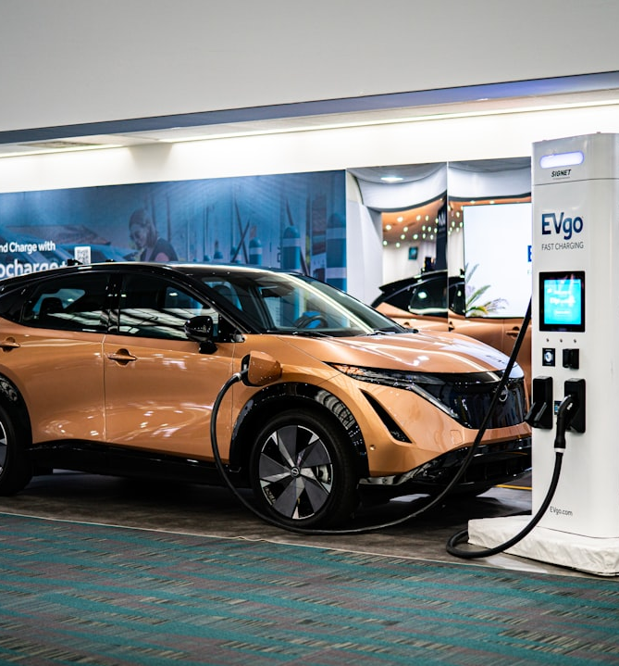
Europe can't fast-charge
Fast-charging isn't workable as European grids cannot support 1000kW charging.
The French transmission system operator, RTE, believes around €100 billion of grid upgrades would be required.
Comparatively building our swap stations was cost less than €5 billion in France.
© 2025 JASPER EV TECH

Slide 12
Iberian Grid Crash
April 28, 2025: Major blackout in Spain, Portugal, and parts of France
15 GW lost in 5 seconds — ~60% of Spain’s electricity supply
Caused disconnection from EU grid; millions left without power
This supports us because:
Swapping reduces grid strain by charging batteries during off-peak hours
Acts as decentralized energy buffer—can stabilize demand and supply
Less vulnerable to sudden frequency drops or high load shocks
Enhances EV infrastructure resilience during grid instability events
© 2025 JASPER EV TECH

Slide 13
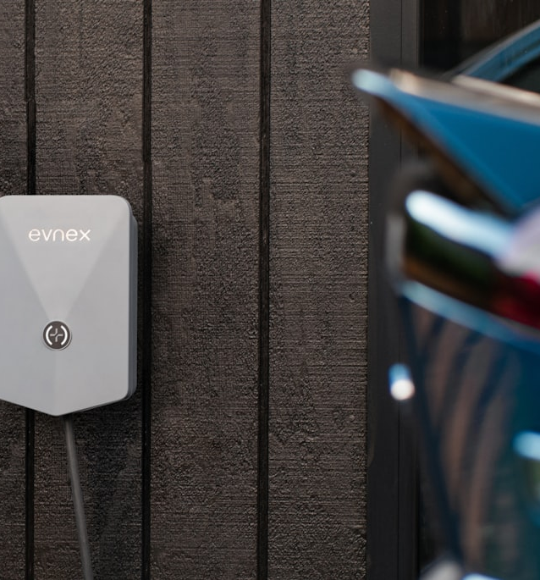
Europe wants to protect its automakers
European automakers prefer local tech like Jasper en France over NIO/BYD to:
Maintain supply chain control
Align with EU regulations and green incentives
Reduce dependence on Chinese technology
Support EU strategic autonomy
Strengthen public, political, and consumer trust
© 2025 JASPER EV TECH

Slide 14
Europe: 30M EVs projected by 2030
€15–30B battery swap infrastructure market
NIO (main competitor): Only 21 swap stations in Germany
Huge opportunity to scale:
Fast-charging faces grid limits—requires massive upgrades
Jasper’s system works within current grid capacity
Can even return power to the grid during off-peak hours
Market Opportunity in the European Union
© 2025 JASPER EV TECH

Slide 15
Batteries-as-a-Service (BaaS)
© 2025 JASPER EV TECH

Slide 16
Revenue Streams
Revenue generated per battery exchange.
License technology to electric vehicle manufacturers for integration.
Sale of carbon credits.
Franchise exchange stations.
© 2025 JASPER EV TECH

Slide 17
FUNDING PHASES
Phase 1 - Early Investment (€2M)
Build Prototype
Issuance of Climate Bond
Phase 2 - Bond (€25M)
Initial Pilot -100 vehicles with exchange stations (€10M)
Facilities, Marketing, Admin and Personnel
Debt retirement
Phase 3 - Bond (€125M)
Expanded Pilot (€90M) - 500 vehicles plus exchange stations
Facilities, Marketing, Admin and Personnel
Debt retirement
Phase 4 - Bond (€300M)
EU Market Expansion
Build battery and exchange station factories
Debt retirement
© 2025 JASPER EV TECH

Slide 18
Steps to climate bond
1. Found the French Company
2. SCOPE Certification
3. Endorsements from French govt
4. Negotiate underwriting of bond
5. List Bond on CBI Database
6. Bond is funded
© 2025 JASPER EV TECH
Notes:
ESG bonds are always oversubscribed

Slide 19
Strategic & Commercial Progress
Early-stage agreement with top EU Electric Vehicle manufacturer to be an internal supplier of parts
In conversation with French automation manufacturer to supply exchange station mechanisms
Battery Recycling Plant and Factory with French assembly equipment company
Discussions with city governments and multiple Ministries in France
© 2025 JASPER EV TECH

Slide 20
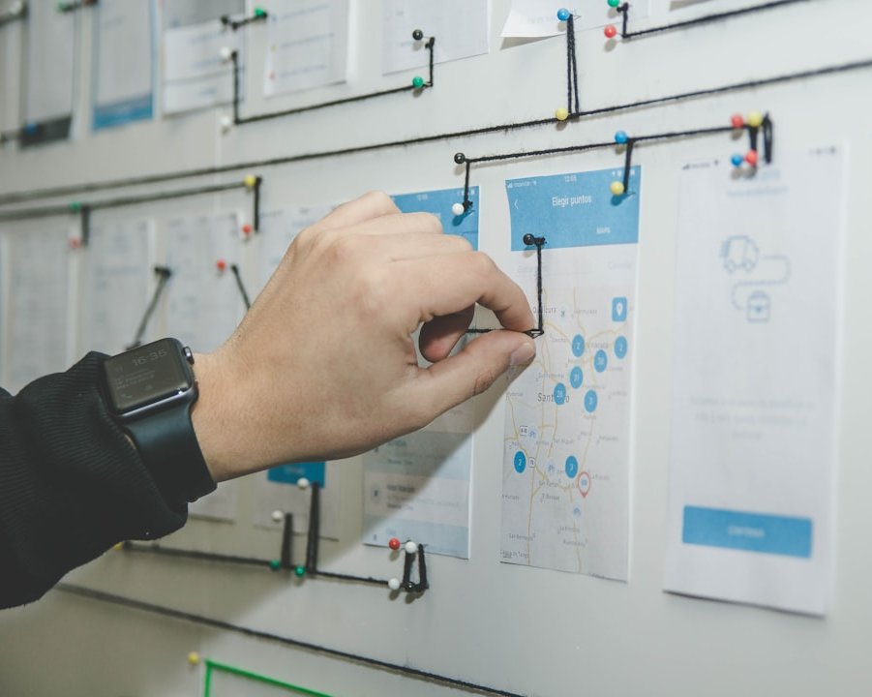
Why invest?
Strategic
Timely
Monopoly on patented IP in ethical, exchangeable EV battery system.
Partner ready with OEMs and municipalities.
Green bond ready.
Scalable
In line with EU regulation and green funding channels.
© 2025 JASPER EV TECH

Slide 21
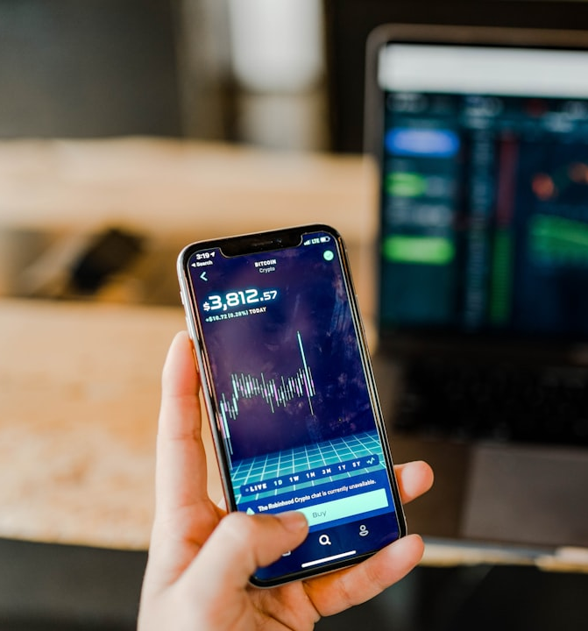
Investor Incentive
€3M investor repayment secured under green bond capital acquisition.
Preferred equity structure for additional early stage investment.
Invest in a system that provides the infrastructure to support the growing market for EVs.
© 2025 JASPER EV TECH

